Slide 1


Analysis of Social Buzz

Slide 2


Today's agenda
Project recap
Problem
The Analytics team
Process
Insights
Summary

Slide 3

Social Buzz is a fast growing technology unicorn that need to adapt quickly to it’s global scale.
Accenture has begun a 3 month POC focusing on these tasks:
1)An adult of Social Buzz’s big data practice
2)Recommendations for a successful IPO
3)Analysis to find Social Buzz’s top 5 most popular categories of content
Project Recap

Slide 4


Problem
Analysis to find Social Buzz’s top 5 most popular categories of content.
Analysis and find where company is flurishing and where it’s lacking.

Slide 5


Andrew Fleming
Chief Technical Architect
The Analytics team
Marcus Rompton
Senior Principle
Meet Mori
Data Analyst

Slide 6
Process
1
Data Understanding
2
Data Cleaning
Data Modelling
3
Data Analysis
4
5
Data Insights

Slide 7
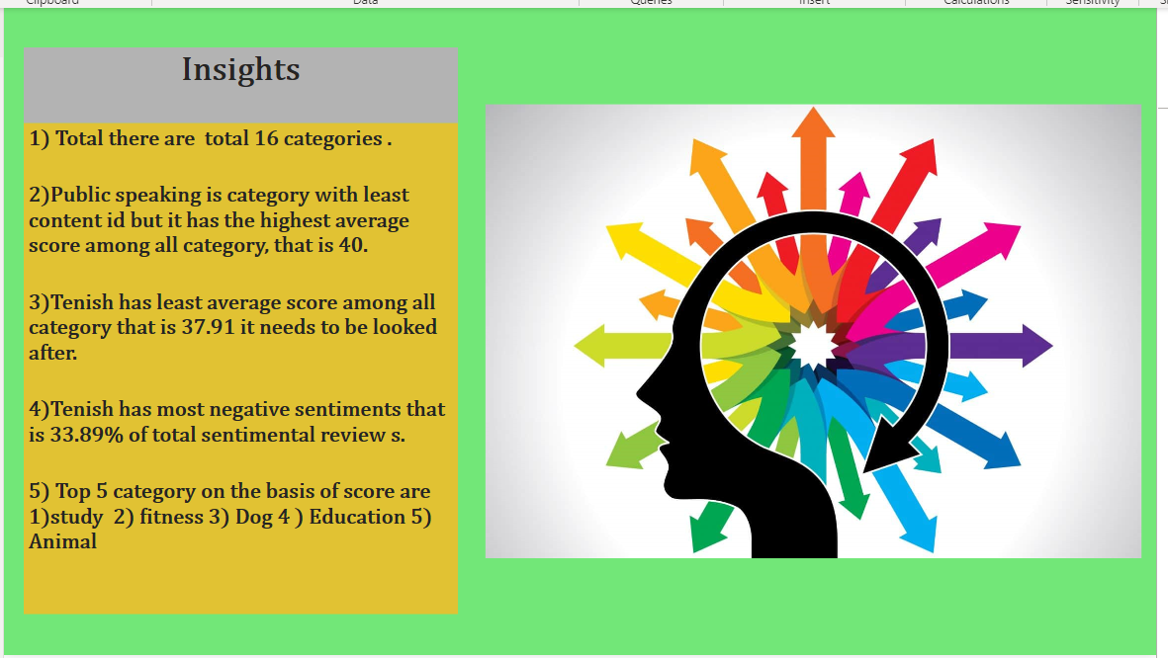

Slide 8
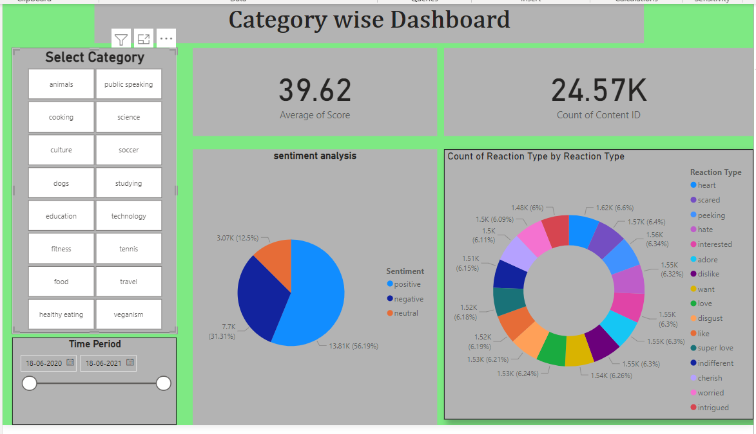

Slide 9


After completing all step with given data by your company
we come on conclusion that your tenish category is in critical
situation which is most need to look after it .
Summary
Top 5 category according performances are : Study ,Education,
Fitness,Dog, Animal.

Slide 10

Thank you!
ANY QUESTIONS?

